Slide 1

TEST OF HYPOTHESIS
ML LABS PVT LTD || WWW.ANALYTICS6.COM || DATA SCIENCE , AI , ML ,COMPUTER VISION || TRAINING AND CONSULTING
Phone Number : 91-6362546088 || Email : contact@analytics6.com

Slide 2
Testing of hypothesis
A hypothesis is an assumption about the population parameter which is to be tested.
ML LABS PVT LTD || WWW.ANALYTICS6.COM || DATA SCIENCE , AI , ML ,COMPUTER VISION || TRAINING AND CONSULTING
Phone Number : 91-6362546088 || Email : contact@analytics6.com

Slide 3
Testing of hypothesis
For that we collect sample data , then we calculate sample statistics (say sample mean) and then use this information to judge or decide whether hypothesized value of population parameter is correct or not.
ML LABS PVT LTD || WWW.ANALYTICS6.COM || DATA SCIENCE , AI , ML ,COMPUTER VISION || TRAINING AND CONSULTING
Phone Number : 91-6362546088 || Email : contact@analytics6.com

Slide 4
Statistical inference
Two important parts of statistical inference are :
- Estimation of parameter
- Testing of hypothesis
ML LABS PVT LTD || WWW.ANALYTICS6.COM || DATA SCIENCE , AI , ML ,COMPUTER VISION || TRAINING AND CONSULTING
Phone Number : 91-6362546088 || Email : contact@analytics6.com

Slide 5
Estimation
It is a procedure of making judgement about the true but unknown values of the population parameter from the sample observations.
ML LABS PVT LTD || WWW.ANALYTICS6.COM || DATA SCIENCE , AI , ML ,COMPUTER VISION || TRAINING AND CONSULTING
Phone Number : 91-6362546088 || Email : contact@analytics6.com

Slide 6
Estimation
It is further divided into two parts
- Point Estimation
- Interval Estimation
ML LABS PVT LTD || WWW.ANALYTICS6.COM || DATA SCIENCE , AI , ML ,COMPUTER VISION || TRAINING AND CONSULTING
Phone Number : 91-6362546088 || Email : contact@analytics6.com

Slide 7
Point Estimation
A point estimator draws inferences about a population by estimating the value of an unknown parameter.
If we express an estimate by a single value, it is called point estimation.
ML LABS PVT LTD || WWW.ANALYTICS6.COM || DATA SCIENCE , AI , ML ,COMPUTER VISION || TRAINING AND CONSULTING
Phone Number : 91-6362546088 || Email : contact@analytics6.com

Slide 8
Point Estimation
For example :
The value of x bar computed from a sample of size n is a point estimate of the population parameter μ
ML LABS PVT LTD || WWW.ANALYTICS6.COM || DATA SCIENCE , AI , ML ,COMPUTER VISION || TRAINING AND CONSULTING
Phone Number : 91-6362546088 || Email : contact@analytics6.com

Slide 9
Interval Estimation
An interval estimator draws inferences about a population by estimating the value of an unknown parameter using an interval.
ML LABS PVT LTD || WWW.ANALYTICS6.COM || DATA SCIENCE , AI , ML ,COMPUTER VISION || TRAINING AND CONSULTING
Phone Number : 91-6362546088 || Email : contact@analytics6.com

Slide 10
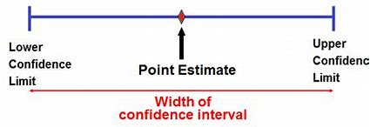
Interval Estimation
The population parameter of interest is between some lower and upper bounds.
ML LABS PVT LTD || WWW.ANALYTICS6.COM || DATA SCIENCE , AI , ML ,COMPUTER VISION || TRAINING AND CONSULTING
Phone Number : 91-6362546088 || Email : contact@analytics6.com

Slide 11
Estimation
Point estimate : A single statistic value that is the “best guess” for the parameter value.
ML LABS PVT LTD || WWW.ANALYTICS6.COM || DATA SCIENCE , AI , ML ,COMPUTER VISION || TRAINING AND CONSULTING
Phone Number : 91-6362546088 || Email : contact@analytics6.com

Slide 12
Estimation
Interval estimate : An interval of number around the point estimate , that has a fixed “confidence level” of containing the parameter value called a confidence interval.
ML LABS PVT LTD || WWW.ANALYTICS6.COM || DATA SCIENCE , AI , ML ,COMPUTER VISION || TRAINING AND CONSULTING
Phone Number : 91-6362546088 || Email : contact@analytics6.com

Slide 13
Methods of finding estimators
Point estimators
Interval estimators
Method of movement
Maximum likelihood estimators
Bayes estimators
Inverting a test statistic
Pivotal quantities
Pivoting the CDF
Bayesian intervals
ML LABS PVT LTD || WWW.ANALYTICS6.COM || DATA SCIENCE , AI , ML ,COMPUTER VISION || TRAINING AND CONSULTING
Phone Number : 91-6362546088 || Email : contact@analytics6.com

Slide 14
Bayes
Bayes theorem is a branch of logic applied to decision making and inferential statistics that deals with probability inference and is used to predict the future events based upon the knowledge of previous events.
ML LABS PVT LTD || WWW.ANALYTICS6.COM || DATA SCIENCE , AI , ML ,COMPUTER VISION || TRAINING AND CONSULTING
Phone Number : 91-6362546088 || Email : contact@analytics6.com

Slide 15
Bayes
Bayes statistics uses “probability” to express subjective “degree of belief”’ in a specific outcome of interest.
Based on prior belief, and constantly updated an addition of new data, Bayesian statistics provides a formal statistical framework for updating probabilities and incorporating even assumed prior knowledge.
ML LABS PVT LTD || WWW.ANALYTICS6.COM || DATA SCIENCE , AI , ML ,COMPUTER VISION || TRAINING AND CONSULTING
Phone Number : 91-6362546088 || Email : contact@analytics6.com

Slide 16
Large sample test
Test of single mean
Test of significance of difference between two means
Test of significance of difference between two std. deviation
ML LABS PVT LTD || WWW.ANALYTICS6.COM || DATA SCIENCE , AI , ML ,COMPUTER VISION || TRAINING AND CONSULTING
Phone Number : 91-6362546088 || Email : contact@analytics6.com

Slide 17
Large sample test
Test of single proportion
Test of significance of difference between two proportions
ML LABS PVT LTD || WWW.ANALYTICS6.COM || DATA SCIENCE , AI , ML ,COMPUTER VISION || TRAINING AND CONSULTING
Phone Number : 91-6362546088 || Email : contact@analytics6.com

Slide 18
Null hypothesis
A statistical hypothesis which is written for the possible acceptance is called Null hypothesis.it is denoted by H₀
ML LABS PVT LTD || WWW.ANALYTICS6.COM || DATA SCIENCE , AI , ML ,COMPUTER VISION || TRAINING AND CONSULTING
Phone Number : 91-6362546088 || Email : contact@analytics6.com

Slide 19
Null hypothesis
In Null hypothesis if the parameter assumes specific value then it is called Simple hypothesis.
In null hypothesis if the parameter assumes set of values then it is called Composite hypothesis.
ML LABS PVT LTD || WWW.ANALYTICS6.COM || DATA SCIENCE , AI , ML ,COMPUTER VISION || TRAINING AND CONSULTING
Phone Number : 91-6362546088 || Email : contact@analytics6.com

Slide 20
Null hypothesis
Example
A biologist wants to test whether or not the true mean weight of a certain species of turtles is 300 pounds. To test this, he goes out and measures the weight of a random sample of 40 turtles.
Here is how to write the null and alternative hypotheses for this scenario:
ML LABS PVT LTD || WWW.ANALYTICS6.COM || DATA SCIENCE , AI , ML ,COMPUTER VISION || TRAINING AND CONSULTING
Phone Number : 91-6362546088 || Email : contact@analytics6.com

Slide 21
Null hypothesis
Example
H₀: μ = 300 (the true mean weight is equal to 300 pounds)
H_{A}: μ ≠ 300 (the true mean weight is not equal to 300 pounds)
ML LABS PVT LTD || WWW.ANALYTICS6.COM || DATA SCIENCE , AI , ML ,COMPUTER VISION || TRAINING AND CONSULTING
Phone Number : 91-6362546088 || Email : contact@analytics6.com

Slide 22
Alternative hypothesis
It is defined as the prediction that there is a measurable interaction between variables.
It is denoted by H_{A}
Null hypothesis is opposed by alternative hypothesis.
When Null hypothesis is rejected , alternative hypothesis is not rejected and vice versa.
ML LABS PVT LTD || WWW.ANALYTICS6.COM || DATA SCIENCE , AI , ML ,COMPUTER VISION || TRAINING AND CONSULTING
Phone Number : 91-6362546088 || Email : contact@analytics6.com

Slide 23
Type 1 and type 2 error
There are four possible results:
The hypothesis is true but our test accepts it.
The hypothesis is false but our test rejects it.
ML LABS PVT LTD || WWW.ANALYTICS6.COM || DATA SCIENCE , AI , ML ,COMPUTER VISION || TRAINING AND CONSULTING
Phone Number : 91-6362546088 || Email : contact@analytics6.com

Slide 24
Type 1 and type 2 error
The hypothesis is true but our test rejects it.
The hypothesis is false but our test accepts it.
These 2 possibilities lead to errors.
ML LABS PVT LTD || WWW.ANALYTICS6.COM || DATA SCIENCE , AI , ML ,COMPUTER VISION || TRAINING AND CONSULTING
Phone Number : 91-6362546088 || Email : contact@analytics6.com

Slide 25
Type 1 and type 2 error
Rejecting a null hypothesis when it is true is called a Type 1 error.
Accepting a null hypothesis when it is false is called Type 2 error.
ML LABS PVT LTD || WWW.ANALYTICS6.COM || DATA SCIENCE , AI , ML ,COMPUTER VISION || TRAINING AND CONSULTING
Phone Number : 91-6362546088 || Email : contact@analytics6.com

Slide 26
Why Confidence interval?
A confidence interval displays the probability that a parameter will fall between a pair of values around the mean.
Confidence intervals measure the degree of uncertainty or certainty in a sampling method.
They are most often constructed using confidence levels of 95% or 99%.
ML LABS PVT LTD || WWW.ANALYTICS6.COM || DATA SCIENCE , AI , ML ,COMPUTER VISION || TRAINING AND CONSULTING
Phone Number : 91-6362546088 || Email : contact@analytics6.com

Slide 27
What exactly is Confidence interval?
A confidence interval is the mean of your estimate plus and minus the variation in that estimate.
This is the range of values you expect your estimate to fall between if you redo your test, within a certain level of confidence.
ML LABS PVT LTD || WWW.ANALYTICS6.COM || DATA SCIENCE , AI , ML ,COMPUTER VISION || TRAINING AND CONSULTING
Phone Number : 91-6362546088 || Email : contact@analytics6.com

Slide 28
What exactly is Confidence interval?
Confidence, in statistics, is another way to describe probability.
For example, if you construct a confidence interval with a 95% confidence level, you are confident that 95 out of 100 times the estimate will fall between the upper and lower values specified by the confidence interval.
ML LABS PVT LTD || WWW.ANALYTICS6.COM || DATA SCIENCE , AI , ML ,COMPUTER VISION || TRAINING AND CONSULTING
Phone Number : 91-6362546088 || Email : contact@analytics6.com

Slide 29
When do you use Confidence interval?
You can calculate confidence intervals for many kinds of statistical estimates, including:
Proportions
Population means
Differences between population means or proportions
Estimates of variation among groups
ML LABS PVT LTD || WWW.ANALYTICS6.COM || DATA SCIENCE , AI , ML ,COMPUTER VISION || TRAINING AND CONSULTING
Phone Number : 91-6362546088 || Email : contact@analytics6.com

Slide 30
Calculating a Confidence interval
Most statistical programs will include the confidence interval of the estimate when you run a statistical test.
If you want to calculate a confidence interval on your own, you need to know:
The point estimate you are constructing the confidence interval for
The critical values for the test statistic.
ML LABS PVT LTD || WWW.ANALYTICS6.COM || DATA SCIENCE , AI , ML ,COMPUTER VISION || TRAINING AND CONSULTING
Phone Number : 91-6362546088 || Email : contact@analytics6.com

Slide 31
Calculating a Confidence interval
3.The standard deviation of the sample
4. The sample size
Once you know each of these components, you can calculate the confidence interval for your estimate by plugging them into the confidence interval formula that corresponds to your data.
ML LABS PVT LTD || WWW.ANALYTICS6.COM || DATA SCIENCE , AI , ML ,COMPUTER VISION || TRAINING AND CONSULTING
Phone Number : 91-6362546088 || Email : contact@analytics6.com

Slide 32
Confidence interval t-test
Confidence intervals are conducted using statistical methods, such as a t-test.
A t-test is a type of inferential statistic used to determine if there is a significant difference between the means of two groups, which may be related in certain features.
ML LABS PVT LTD || WWW.ANALYTICS6.COM || DATA SCIENCE , AI , ML ,COMPUTER VISION || TRAINING AND CONSULTING
Phone Number : 91-6362546088 || Email : contact@analytics6.com

Slide 33
Confidence interval t-test
Calculating a t-test requires three key data values.
They include the difference between the mean values from each data set (called the mean difference), the standard deviation of each group, and the number of data values of each group.
ML LABS PVT LTD || WWW.ANALYTICS6.COM || DATA SCIENCE , AI , ML ,COMPUTER VISION || TRAINING AND CONSULTING
Phone Number : 91-6362546088 || Email : contact@analytics6.com

Slide 34
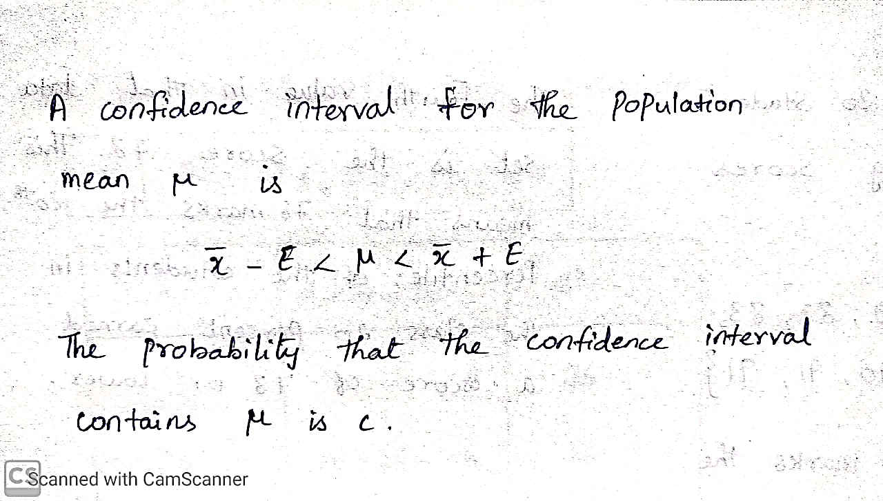
Confidence interval
ML LABS PVT LTD || WWW.ANALYTICS6.COM || DATA SCIENCE , AI , ML ,COMPUTER VISION || TRAINING AND CONSULTING
Phone Number : 91-6362546088 || Email : contact@analytics6.com

Slide 35
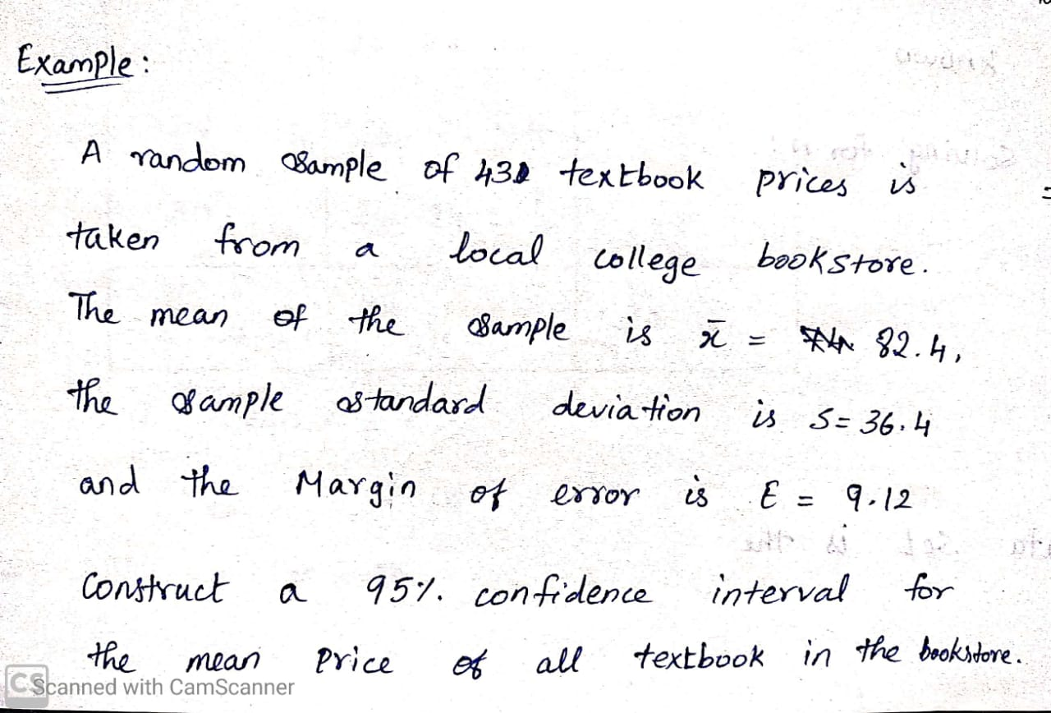
Confidence interval
ML LABS PVT LTD || WWW.ANALYTICS6.COM || DATA SCIENCE , AI , ML ,COMPUTER VISION || TRAINING AND CONSULTING
Phone Number : 91-6362546088 || Email : contact@analytics6.com

Slide 36
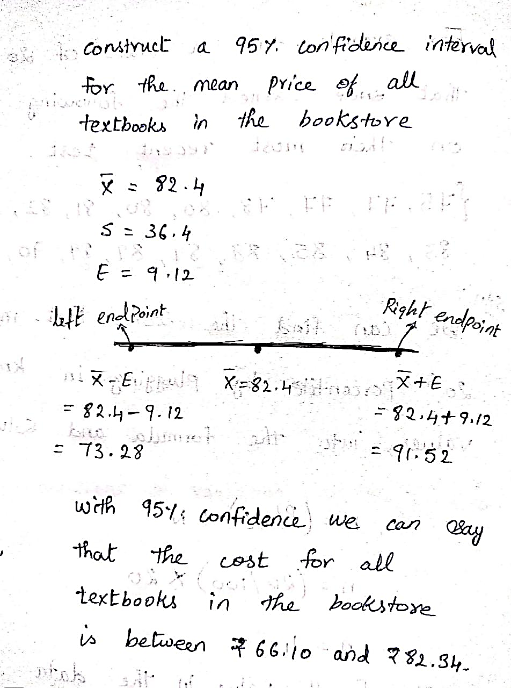
Confidence interval
ML LABS PVT LTD || WWW.ANALYTICS6.COM || DATA SCIENCE , AI , ML ,COMPUTER VISION || TRAINING AND CONSULTING
Phone Number : 91-6362546088 || Email : contact@analytics6.com

Slide 37
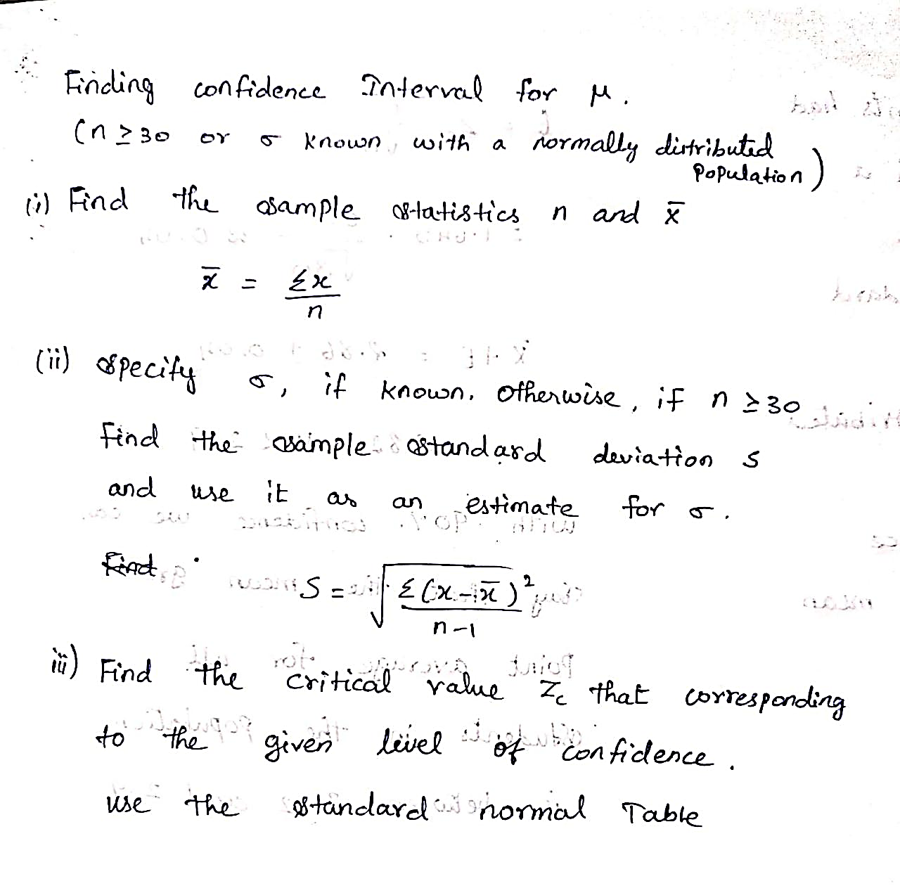
Find Confidence interval
ML LABS PVT LTD || WWW.ANALYTICS6.COM || DATA SCIENCE , AI , ML ,COMPUTER VISION || TRAINING AND CONSULTING
Phone Number : 91-6362546088 || Email : contact@analytics6.com

Slide 38
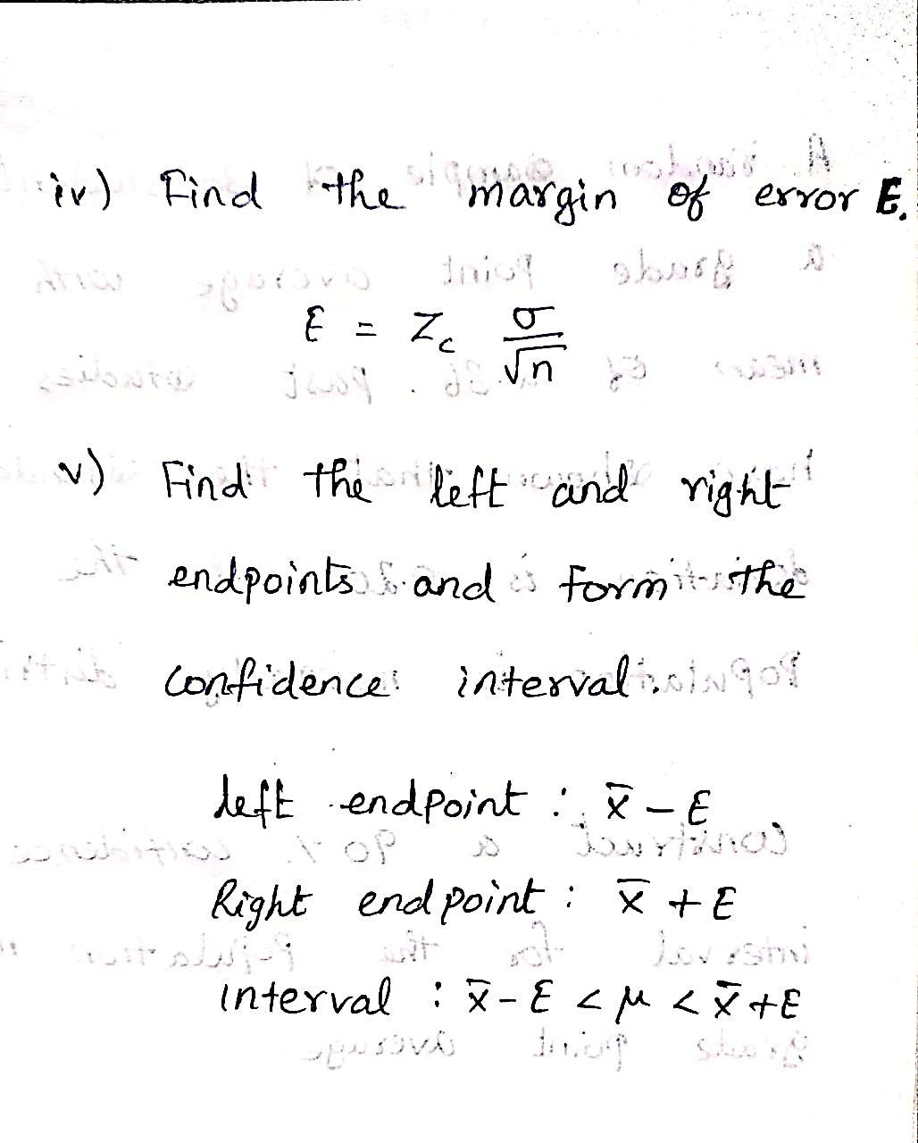
Confidence interval
ML LABS PVT LTD || WWW.ANALYTICS6.COM || DATA SCIENCE , AI , ML ,COMPUTER VISION || TRAINING AND CONSULTING
Phone Number : 91-6362546088 || Email : contact@analytics6.com

Slide 39
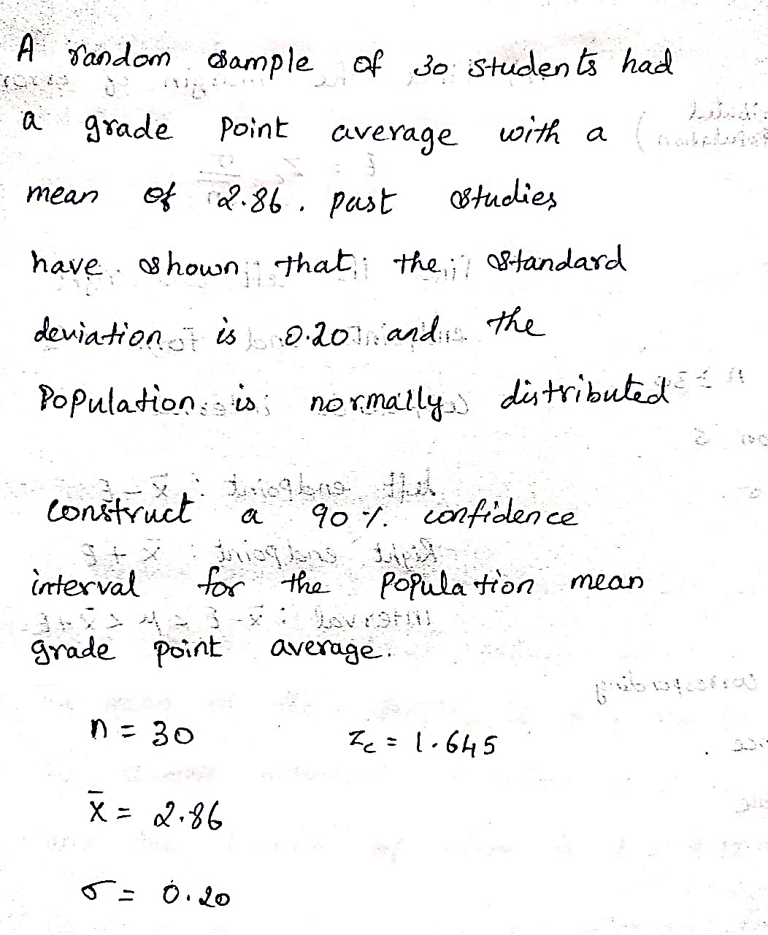
Confidence interval
ML LABS PVT LTD || WWW.ANALYTICS6.COM || DATA SCIENCE , AI , ML ,COMPUTER VISION || TRAINING AND CONSULTING
Phone Number : 91-6362546088 || Email : contact@analytics6.com

Slide 40
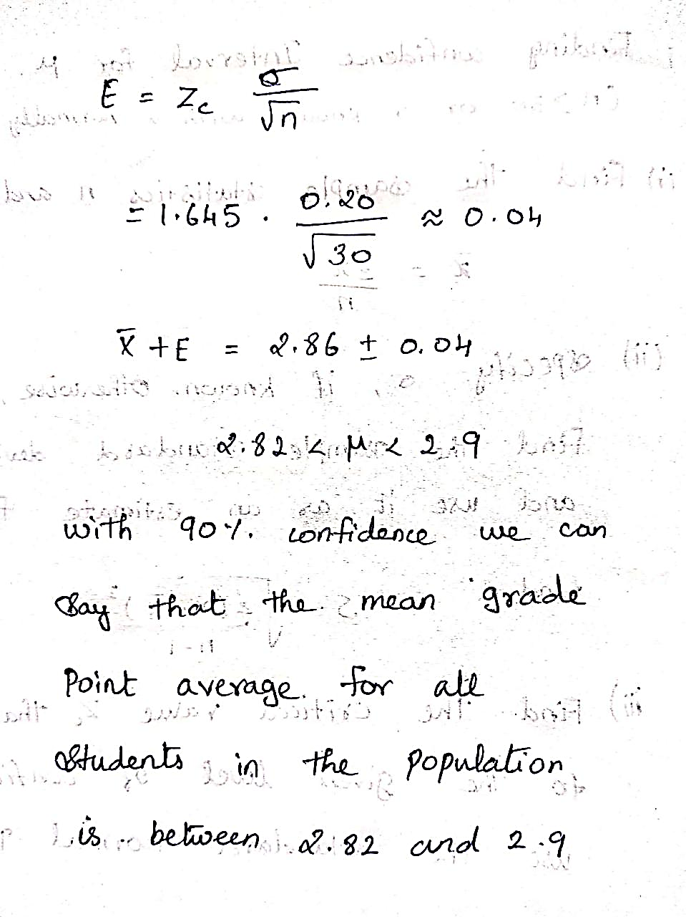
Confidence interval
ML LABS PVT LTD || WWW.ANALYTICS6.COM || DATA SCIENCE , AI , ML ,COMPUTER VISION || TRAINING AND CONSULTING
Phone Number : 91-6362546088 || Email : contact@analytics6.com

